Slide 1




AT82.02
Data Modeling and Management
Unit 2-1: NoSQL Data Model and Management
Chutiporn Anutariya (chuti at ait dot ac dot th)

Slide 2
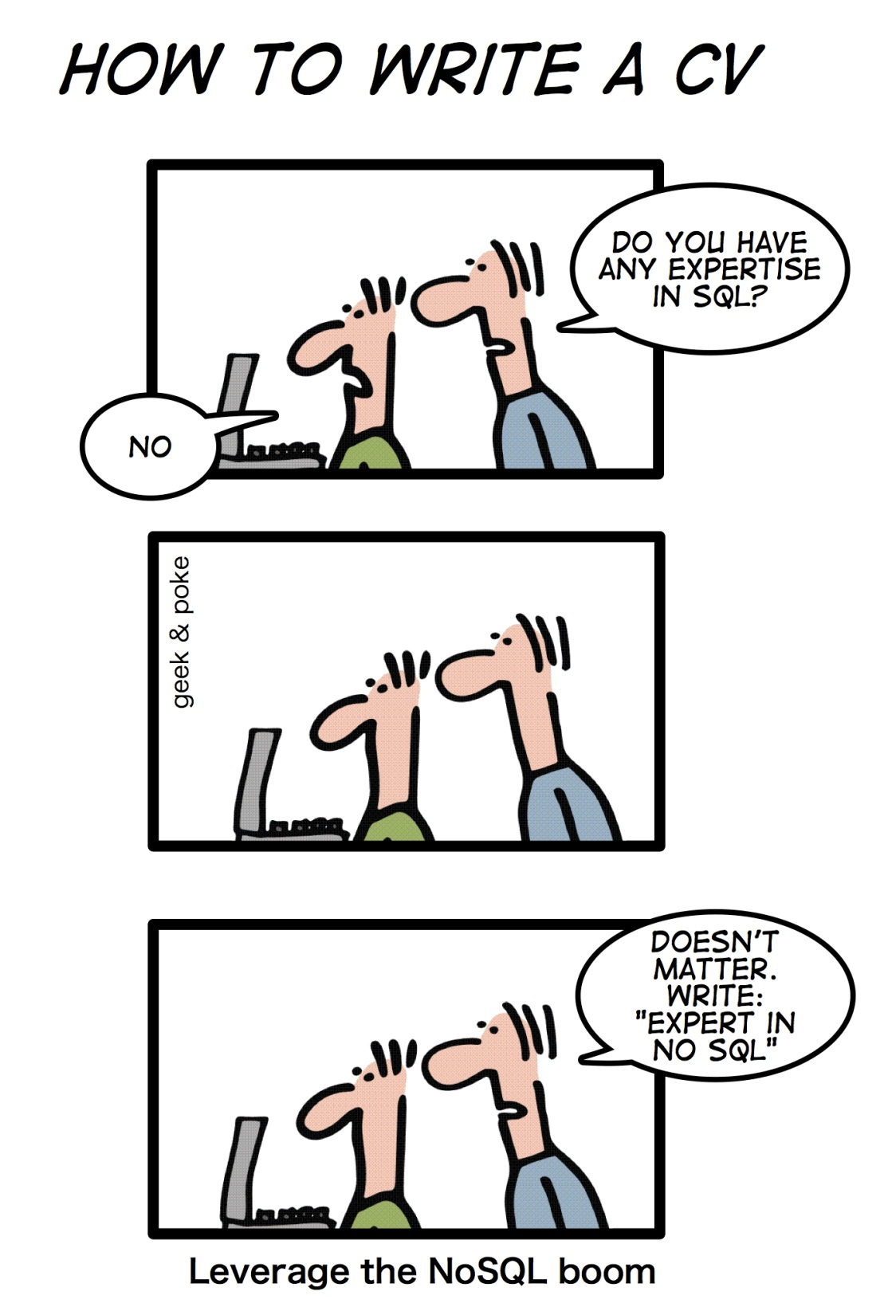

Slide 3
A Little Humor...
3 DATABASE ADMINS
WALKED INTO
A NOSQL BAR …
A LITTLE WHILE LATER
THEY WALKED OUT BECAUSE
THEY COULDN’T FIND A TABLE

Slide 4
Fun Quiz Time!

Slide 5
Recap!
Data Model
describes data characteristics

Slide 6
Relational Database Recap!
Menti.com
Characteristics, Benefits and Limitations

Slide 7
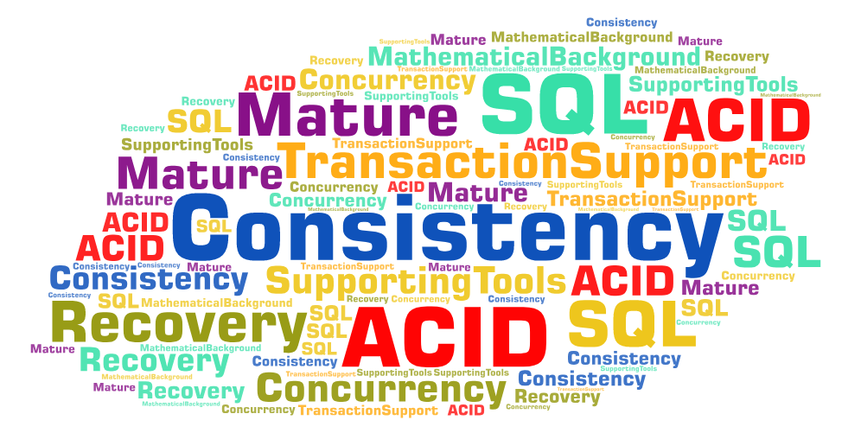
Relational Databases: Characteristics and Benefits

Slide 8
Data Model
RECAP
A data model is a representation that we use to perceive and manipulate our data.
It allows us to:
Represent the data elements under analysis, and
How these are related to each others
This representation depends on our perception.

Slide 9
Data Model: Definition
In this course we will refer “data model” as the model by which the database organize data.
RECAP

Slide 10
Data Model describes data characteristics
RECAP
Structure
Operations
Constraints

Slide 11
Relational Databases: Limitations
Scalability Issues
Scale up vs. Scale out (vertical vs. horizontal)
Not designed to run on clusters / distributed applications
Joins are expensive
Schema-ful Databases vs. Schema-less Databases

Slide 12
Evolution of data models
least
1960
Hierarchical
Difficult to represent M:N relationships (Hierarchical only)
Physical level dependency
No ad hoc queries
Access path predefined (navigational access)
1969
Network
Semantics in Data Model
Provides ad hoc queries
Set-oriented access
Weak semantic content
1970
Relational
1976
Entity Relationship
Easy to understand
Incorporates more semantics
1976
1978
Semantic
More semantics in data model
Support for complex objects
Inheritance
Behavior
1985
1990
Object-Oriented
Extended Relational (Object/Relational)
most
Address Big Data problem
Less semantics in data model
Based on schema-less key-value data model
Best suited for large sparse data stores
2009
Big Data
NoSQL

Slide 13

NoSQL Data Modeling and Management

Slide 14


Concepts and Characteristics

Slide 15
NoSQL Origin
Generally newer databases solving new and different problems;
Not only SQL;
Problems not solved by RDBMSs;
Limitation of RDBMSs, not SQL;

Slide 16
NoSQL is a database technology designed to support the requirements of cloud applications and architected to overcome the scale, performance, data model, and data distribution limitations of relational databases (RDBMS’s).

Slide 17
What is NoSQL?
NoSQL is a term used to describe high-performance, non-relational databases.
NoSQL databases utilize a variety of data models, including document, graph, key-value, and columnar.
NoSQL databases are widely recognized for ease of development, scalable performance, high availability, and resilience.

Slide 18
Why NoSQL?
Triggered by the storage needs of Web 2.0 companies such as Facebook, Google and Amazon.com
Not necessarily well structured – e.g., pictures, documents, web page description, video clips, etc.
Lately of increasing importance due to big data
ACID properties may not hold
Focuses on availability of data even in the presence of multiple failures
Spread data across many storage systems with a high degree of replication.

Slide 19
NoSQL Definition
“Next Generation Databases mostly addressing some of the points: being non-relational, distributed, open-source and horizontal scalable. The original intention has been modern web-scale databases. The movement began early 2009 and is growing rapidly. Often more characteristics apply as: schema-free, easy replication support, simple API, eventually consistent / BASE (not ACID), a huge data amount, and more.”
Ref: www.nosql-database.org

Slide 20
NoSQL vs Relational Model???
Data Model
Transaction Properties
Performance & Scale

Slide 21
NoSQL Distinguishing Characteristics
Large data volumes
Scalable horizontally
Schema-less / No Schema
Do not follow the principles of ACID
Queries need to return answers quickly
Asynchronous Inserts & Updates
CAP Theorem
Open source development

Slide 22
Schema-less Database: what is?
In Relational DB (schema-ful DB), there are limitations:
Cannot add a record which does not fit a schema
Needs to add NULL values to unused data attribute in a record
Strong datatyping
Composite attributes and multivalued attributes are not allowed!!

Slide 23
Schema-less Database: what is?
In Schema-less DB
No fixed, rigid Schema
No NULL constraint/enforcement
No datatyping
This is Schema-less Database!

Slide 24
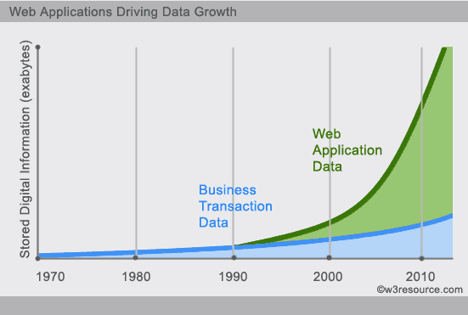
Web Apps Driving Data Growth

Slide 25
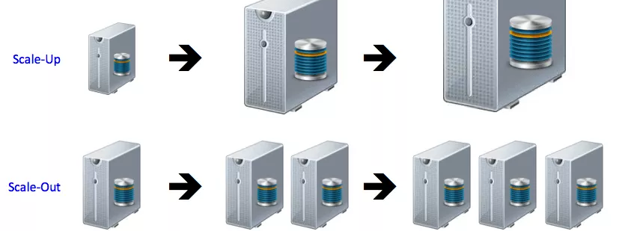
Scale UP vs. Scale OUT

Slide 26
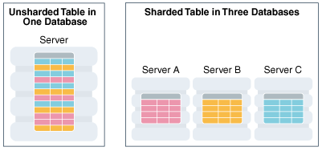
Data Sharding

Slide 27
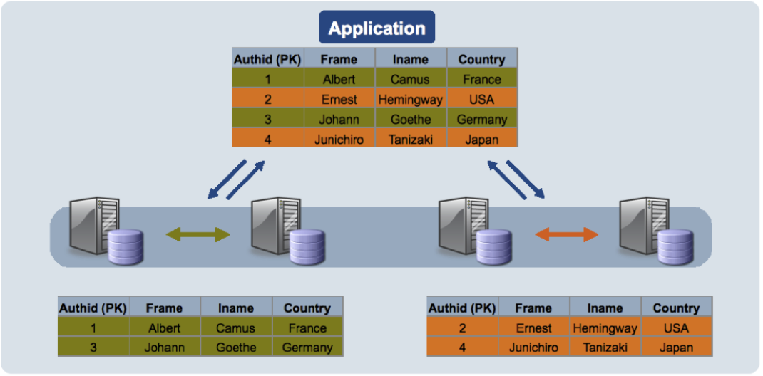
Data Sharding

Slide 28
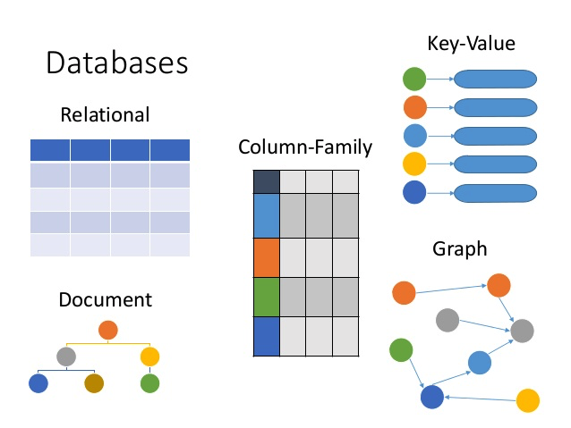
Database Family

Slide 29
Major Categories of NOSQL Data Models

Slide 30
MAJOR CATEGORIES OF NOSQL DATA MODELS
Store data together as columns instead of rows and are optimized for queries over large datasets
Are used to store information about networks, such as social connections
Graph databases
Key-value stores
Wide-column stores
Document databases
Pair each key with a complex data structure known as a document.
Are the simplest. Every item in the database is stored as an attribute name (or "key") together with its value.

Slide 31

Key-Value Model

Slide 32


Key-Value Model
Key
Value
Name: Nadech
Country: Thailand
Age: 30 years
Nadech
Name: Yaya
Program: IM
Facebook: URL
Yaya
Video Object

Slide 33
Key-Value Model
The simplest model: just Keys and Values
No Schema
Keys: synthetic or auto-generated
Values: any object type (e.g., String, JSON, BLOB) stored as uninterpreted block, thus the keys are the only way to retrieve stored data.
Query operations for stored objects are associated with a key:
PUT, GET, DELETE

Slide 34
Benefits vs. Limitations
Benefits
Limitations
Extremely fast retrieval using the key
Virtually no restriction on the type of data that can be stored:
Text (for example, the HTML code for a Web page)
Any type of multimedia binary (still images, audio, and video).
Cannot search within stored values rather than always retrieving by the key
Cannot update parts of a “value” while it’s in the database. You must replace the entire value with a new copy if modifications are needed.

Slide 35
Applications & Use Cases
Best suited for applications where access is only through the key.
They are being used for Web sites that include thousands of pages, large image databases, and large catalogs. They are also particularly useful for keeping Web app session information.

Slide 36

Document Model

Slide 37
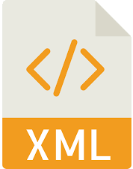
Document Model
A specialized Key-value Store but rather than storing “values,” it stores “documents”, which are not adhered to schema restrictions.
Provides a way to query the documents based on the contents or metadata.
Key
Document
AIT
China

Slide 38
Document Model
A specialized Key-value Store
Designed for storing, retrieving and managing document-oriented information, also known as semi-structured data, such as XML, JSON, BSON
Provides APIs or a query/update language that exposes the ability to query or update based on the internal structure in the document.

Slide 39
{ "FirstName": "Bob", "Address": "5 Oak St.", "Hobby": "sailing" }
<contact> <firstname>Bob</firstname> <lastname>Smith</lastname> <phone type="Cell">(123) 555-0178</phone> <phone type="Work">(890) 555-0133</phone> <address> <type>Home</type> <street1>123 Back St.</street1> <city>Boys</city> <state>AR</state> <zip>32225</zip> <country>US</country> </address> </contact>

Slide 40
CRUD Operations
Creation (or insertion)
Retrieval (or query, search, read or find)
Update (or edit)
Deletion (or removal)

Slide 41

Graph Model

Slide 42
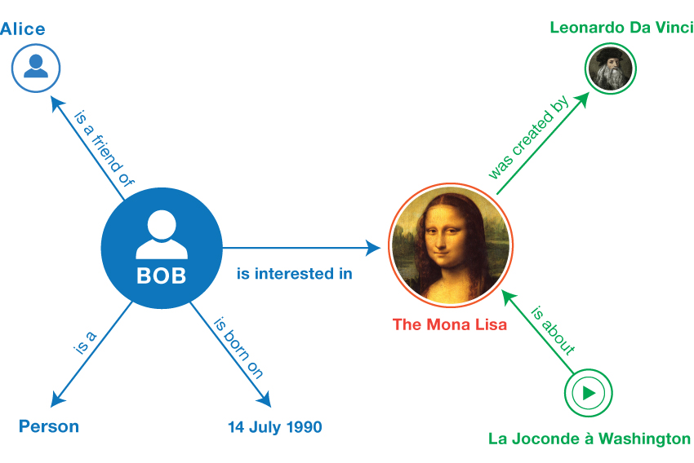
Graph Model (nodes-links-properties structure)

Slide 43
Graph Model
Graph store uses graph structures for semantic queries with nodes, edges and properties to represent and store data.
The relationships allow data in the store to be linked together directly, and in many cases retrieved with one operation.
A query on a graph is known as traversing the graph.
The biggest advantage of the graph store is that joins are not necessary.

Slide 44

Thank you.
Exit Slip:
Summary of What You Learned (max 100 words) What remains unclear (if any)

